Slide 1



Invention of the PC
Notes:
Manav ka Slide

Slide 2
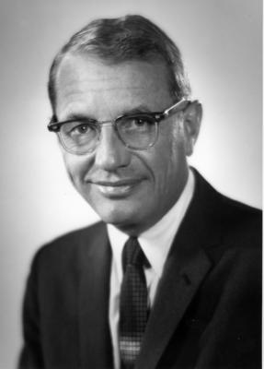
Rise of Xerox :
Founded in 1906 as the Haloid Photographic Company.
Founded by: Joseph .C. Wilson.
The firm obtained commercial rights to xerography in 1947.
Renamed as Xerox Company in 1958.
Became Famous after launch of Xerox 914.

Slide 3
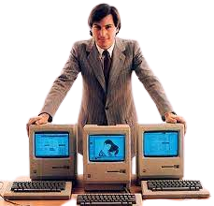
Rise of Apple :
Apple Computer Company was established on April 1, 1976,
by Steve Jobs, Steve Wozniak and Ronald Wayne.
In 1976, Apple sold its first pre-assembled computer, called the Apple-1.
On August 2, 2018,
Apple made history by becoming the first publicly traded U.S. company to be valued at $1 trillion, as measured by market capitalization.
Notes:
Shubham ka slide

Slide 4
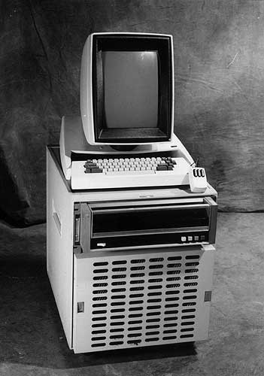
Xerox Alto:
“One of the worst mistakes in the History of TECHNOLOGY”
The Xerox Alto was created in 1972.
The Alto was the first system to have all of the contemporary Graphical User Interface components (GUI)
It was also the first to include Ethernet networking, bit mapping, scalable type.
But, the most important inclusion was that of a Mouse and the world’s first laser printer..
Notes:
Arunim ka slide

Slide 5
Fall of Xerox:
Major fall came in the year 1981, when xerox star was introduced. It was launched in market at a heavy price,
if compared with IBM’s PC having the same features.
Not taking the research/invention seriously made by P.A.R.C.
For Example: The Mouse, GUI, Laser Printer, etc.
Expiring Patents of allowed Chinese and Japanese companies to copy xerox technology and come up with cheaper product.
.
Notes:
Janhavi ka slide

Slide 6
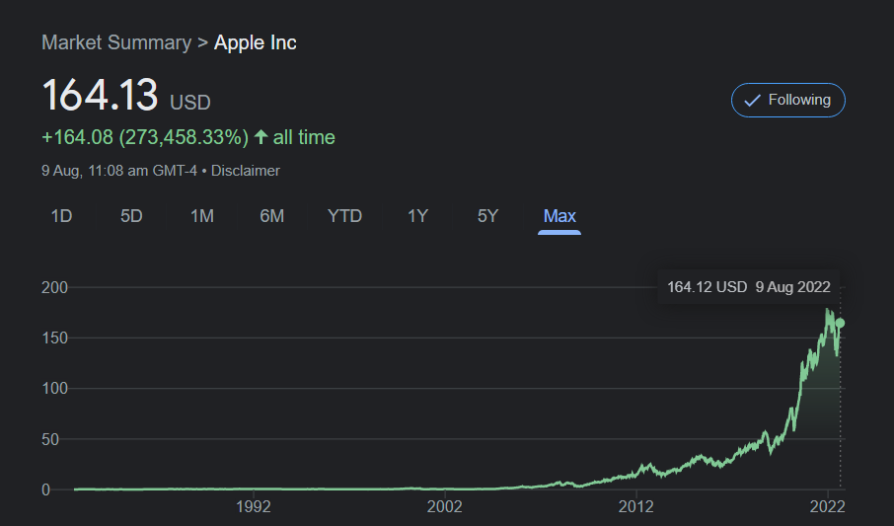
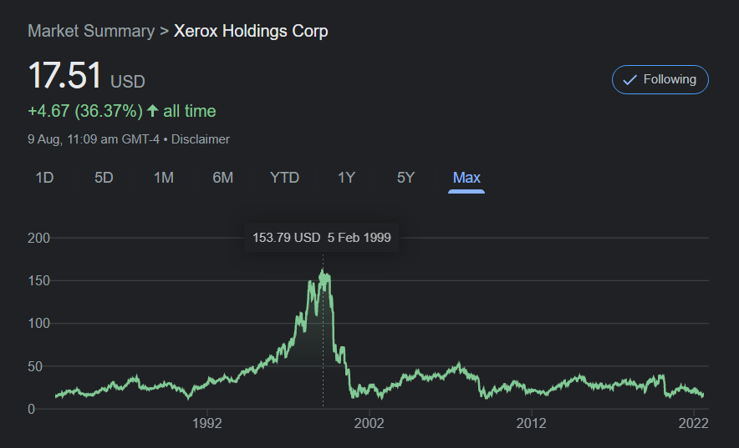
Current Global Market Status:
Surged slow and steady,
introduced new technologies like Iphone, Ipods, etc.
Fell drastically for not innovating
and taking risks.
Notes:
Sarang chi slide

Slide 7
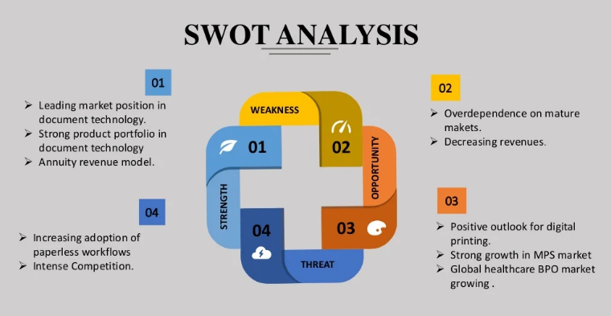
Xerox:
Notes:
Yash sarang

Slide 8
Conclusion:
Steve Jobs did not steal much from Xerox!
The visit to the PARC that day, inspired him to improve on what had already been discovered.
(Like a cut on a diamond)
This is how innovation works.
We can do the same.
We just have to Look around,
get inspired and innovate.
Notes:
Heramb

Slide 9
“Once a new technology rolls over you, if you're not part of the steamroller, you're part of the road”
-David Gardner (American Entrepreneur)
Thank Y
Notes:
Heramb

